Slide 1
Meeting-08
Magician project Update

Slide 2
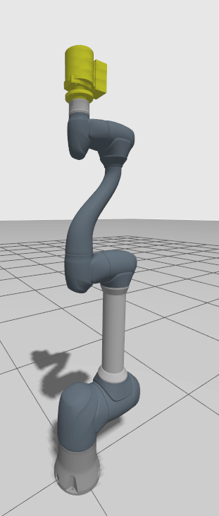
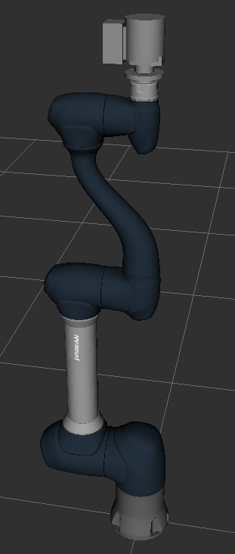
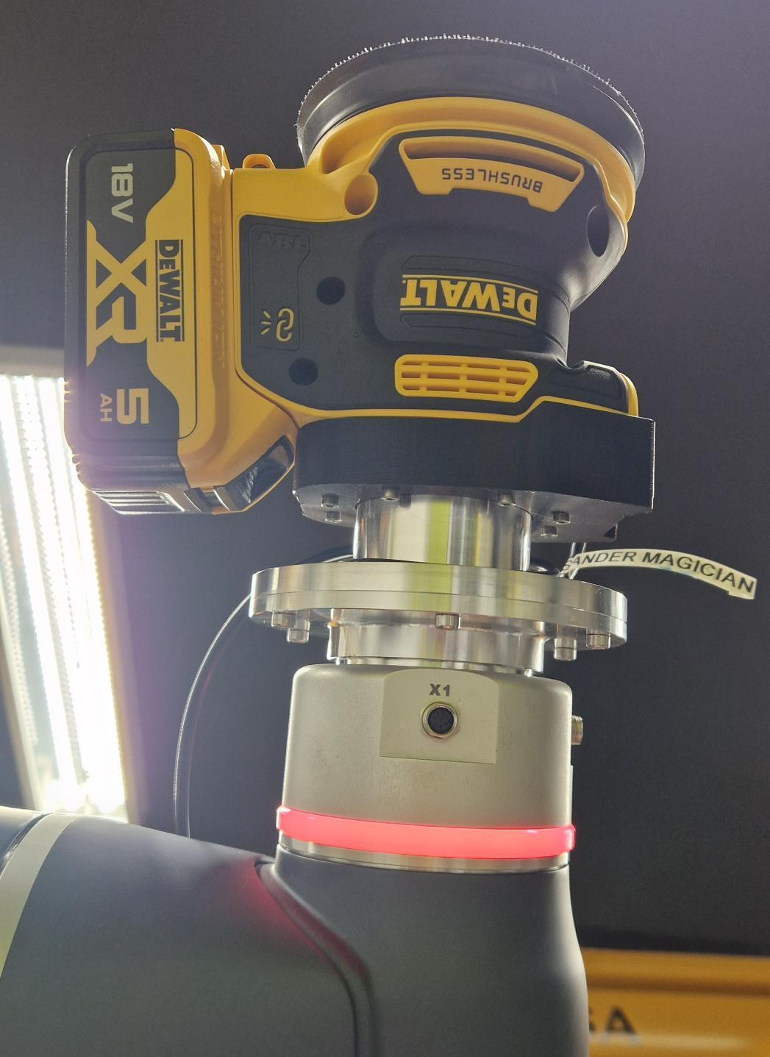
Completed Creating URDF for the Tool Assem
Creating the URDF model of the tool along with assigning the mass and the inertia to it.
Also the tool was equipped with the GPIO cable so that the tool can be controlled by the Doosan robot digital I/O pins

Slide 3
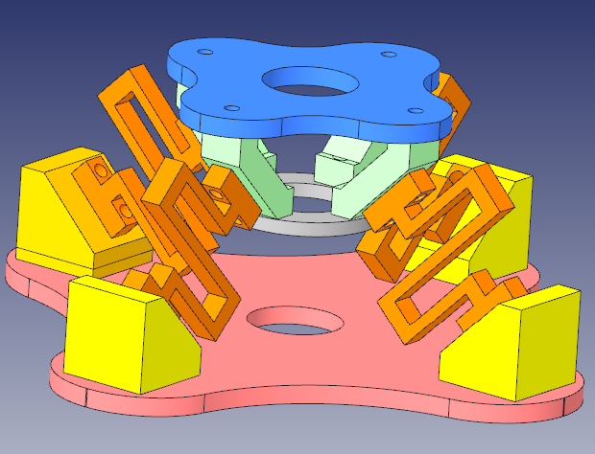
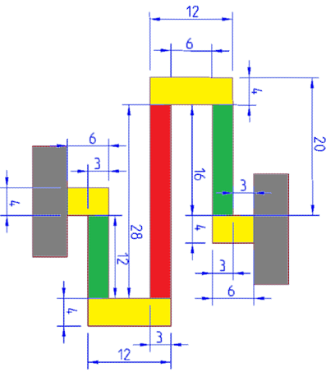
Initial Design and the folded beam Structure

Slide 4
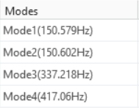
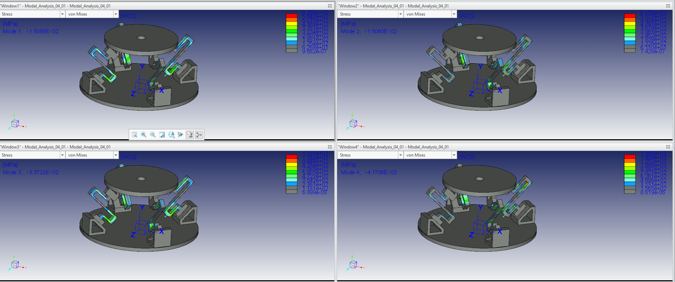
Initial Analysis Results

Slide 5
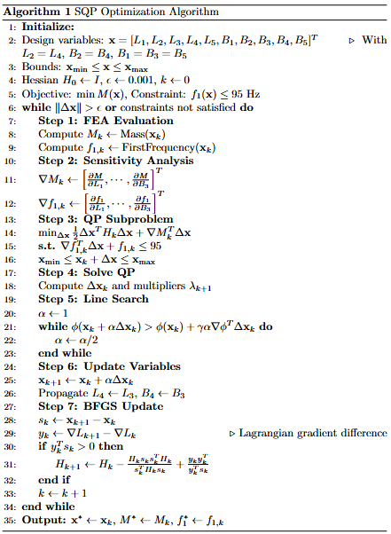
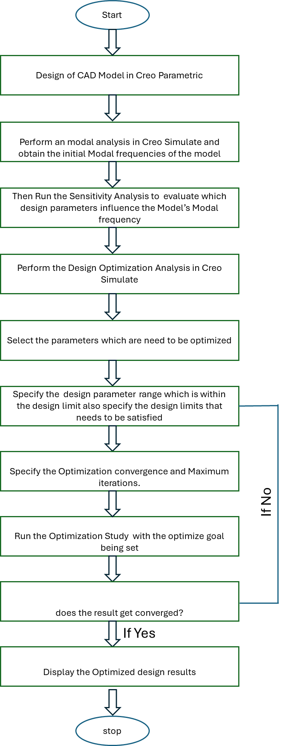

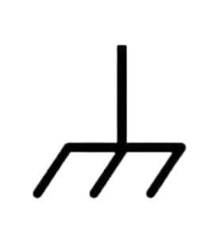
Design Optimization of the Folded beam Structure
L₄
B₄
B₅
L₅
constrained
B₃
L₃
B₁
L₁
B₂
L₂
Iyer, R. B., Jatti, V. K., Yadav, Y., Verma, A., Desai, J., & Dewan, C. P. (2017). Design optimization of CAD model. Materials Today: Proceedings, 4(8), 7357-7364.
constrained

Slide 6
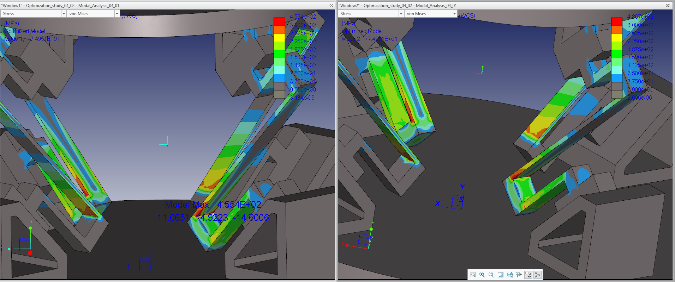
Initial Analysis Results
After Optimization
Here FOS is <1.5 ( Not suitable for Engineering Applications)

Slide 7
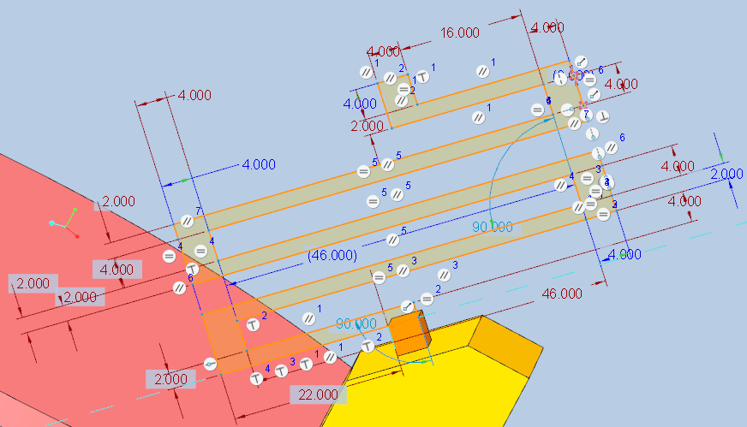
Influential Design Parameters for Optimization
Design Goal: min(total_mass)
Design Limits : Modal frequency < 95 Hz
Variables: ( in mm)
1st Set → all the horizontal length ( 4 parameters)
10< L₁ <20
30< L₂ = L₃ < 50
15 < L₄ < 25
2nd Set → all the horizontal thickness (4 parameters)
1 < T <3
Where, T = T₁ =T₂ = T₃ =T₄
Observations:
Model frequencies are highly dependent on the horizontal beam dimensions .
2) No Variation during Vertical beam dimension changes.
3) From the prior Sensitivity Analysis we could found that the optimal width and height for the vertical beam structures those are
Overall folded beam Width : 5mm
Vertical beam Height:4 mm

Slide 8
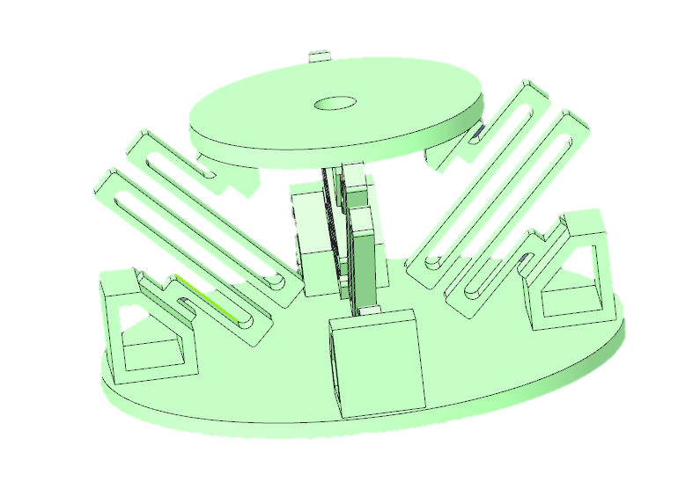
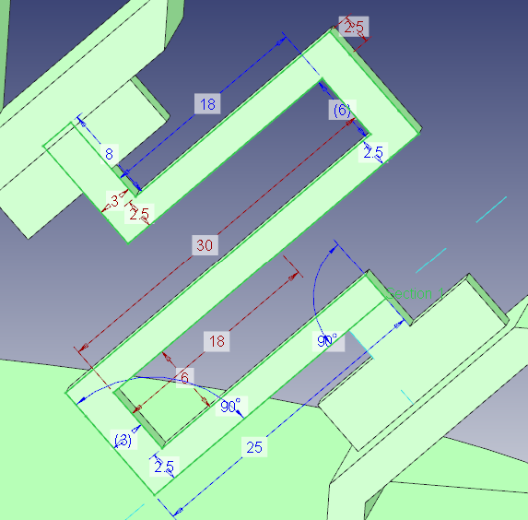

Modified Design and the folded beam Structure
Single bent to double bent with added rounds
Initial Design parameters

Slide 9
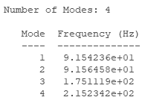
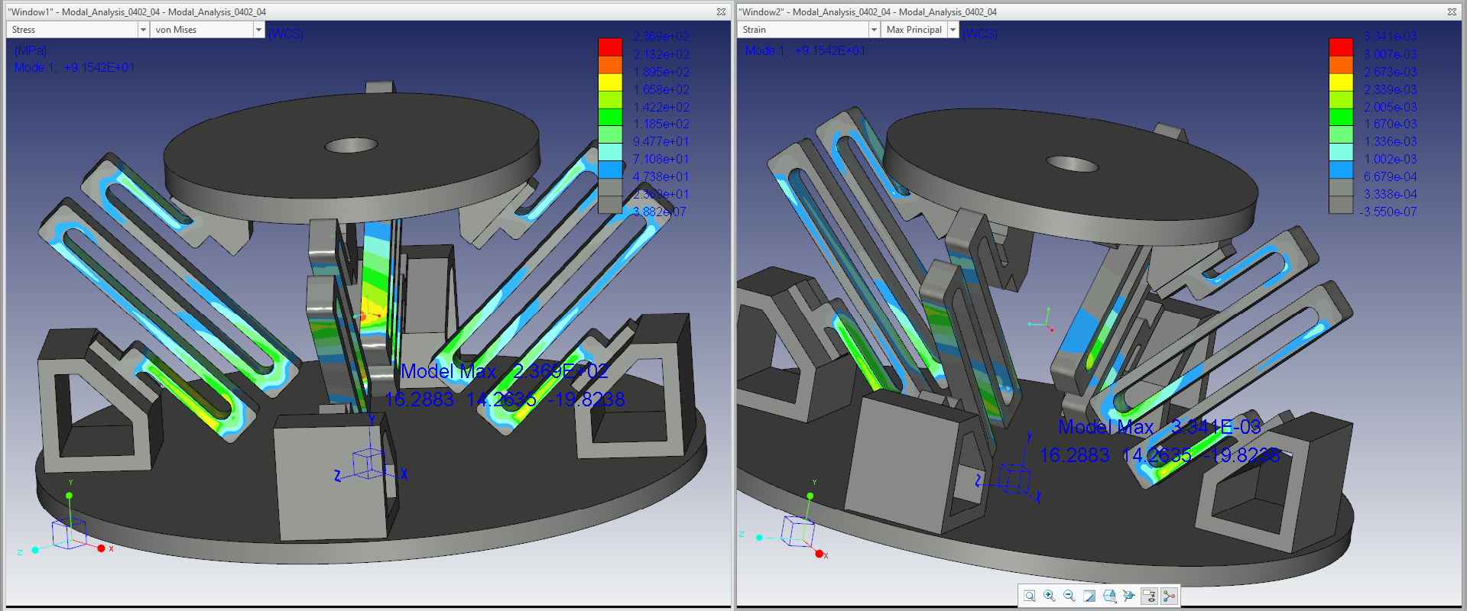
Modified Design after Optimization

Slide 10
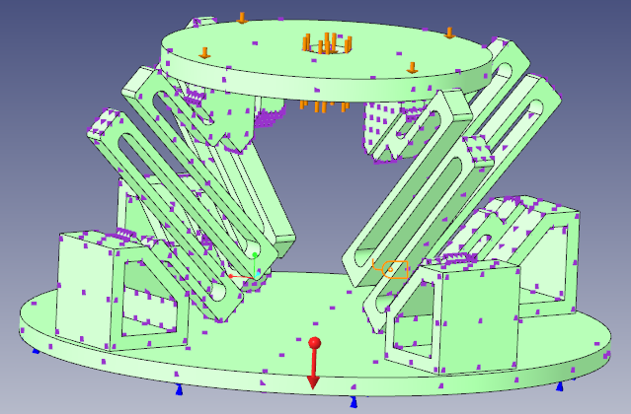
Design Validation Calculations for the Modified Model
Ergal 70
Mechanical Design Calculations (For Initial Version)
The current model is subjected to the tool weight of -25 N , gravitational load of 1g
also, a static load of -20 N in all the 3 axial directions
Maximum Stress – von Mises : 96.82MPa
Maximum Principal Strain : 0.00106
Maximum Strain Energy per Unit Volume : 0.06898 MPa
Factor or Safety ( Calculated) : 2.1223 ( Valid for most of Engineering Applications)

Slide 11
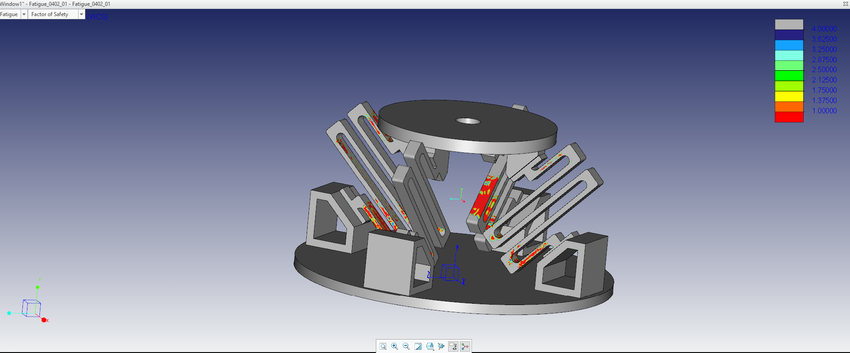
Results from Fatigue Analysis
Tested the Model Fatigue with a Desired Endurance of 2¹⁰ cycles and verified as Safe until 10²⁰ cycles ( Under loading conditions).
After the end of these cycles it’s shown that the modal will be highly effected in the Red Areas . At these spots the model could lead to breakage .

Slide 12
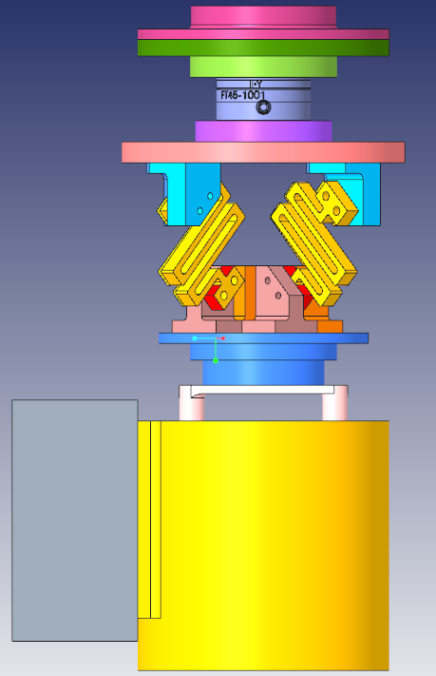

Slide 13
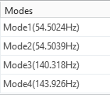
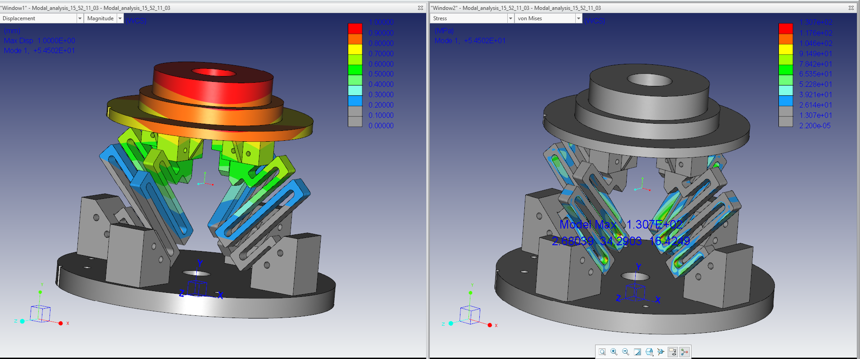
FOS = 3.839

Slide 14
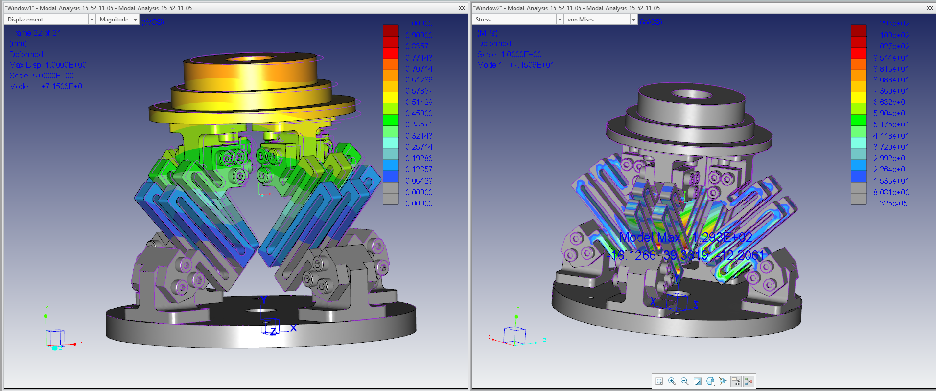
FOS = 3.869
FOS = 3.839

Slide 15
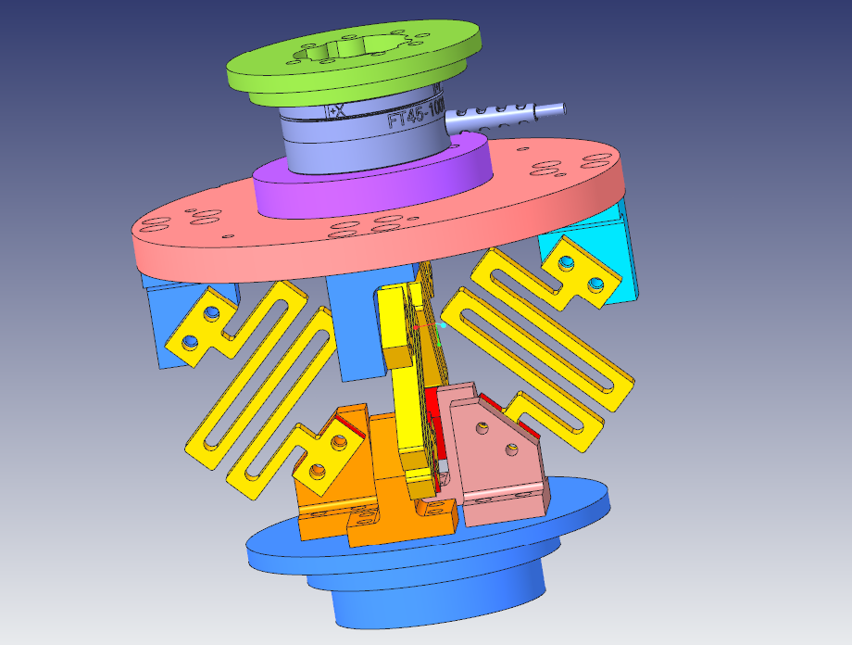

Slide 16
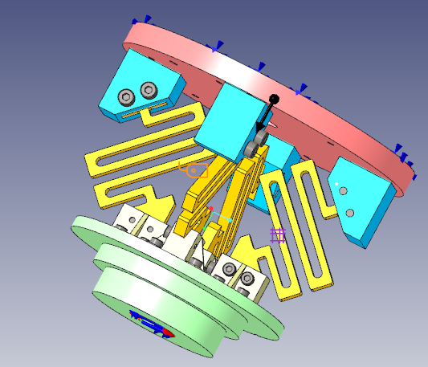
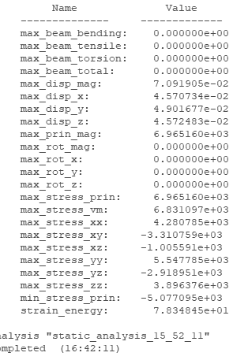






Doosan Robot arm
This stress analysis is actually under loading which is obtained from the ft sensor tests.
In the current analysis we have used the readings from a 0 orientation speed 3 settings in free condition loading ( under self weight)
tool

Slide 17
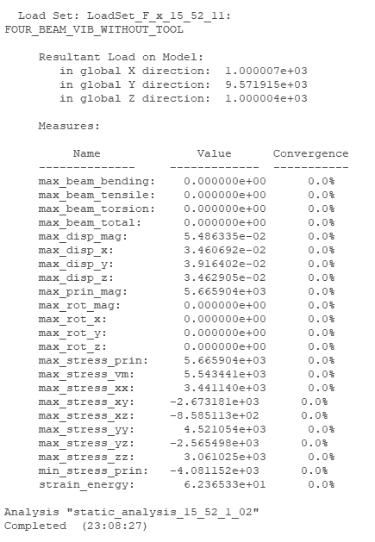
Doosan Robot arm
This stress analysis is actually under loading which is obtained from the ft sensor tests.
In the current analysis we have used the readings from a 0 orientation speed 3 settings in free condition loading ( under self weight)
tool

Slide 18
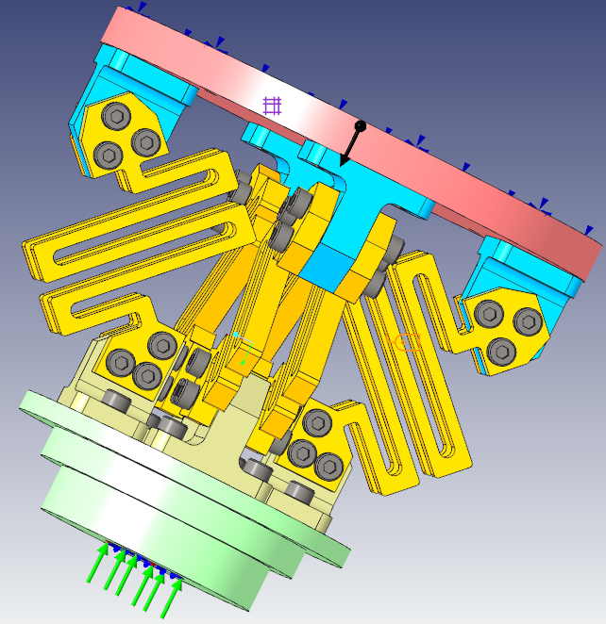
Doosan Robot arm
This stress analysis is actually under loading which is obtained from the ft sensor tests.
In the current analysis we have used the readings from a 0 orientation speed 3 settings in free condition loading ( under self weight)
tool

Slide 19
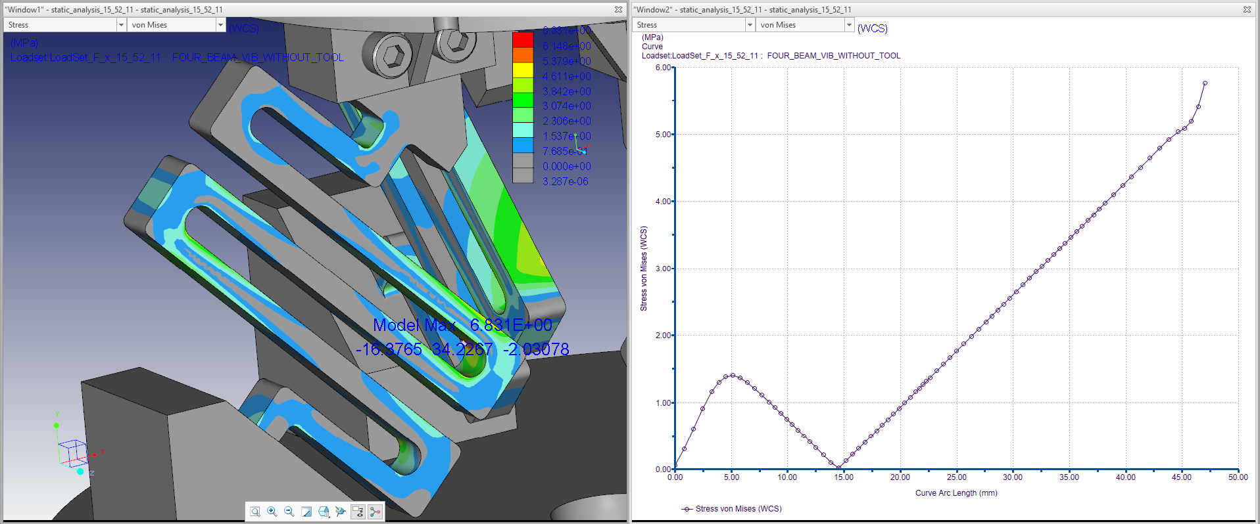

Slide 20
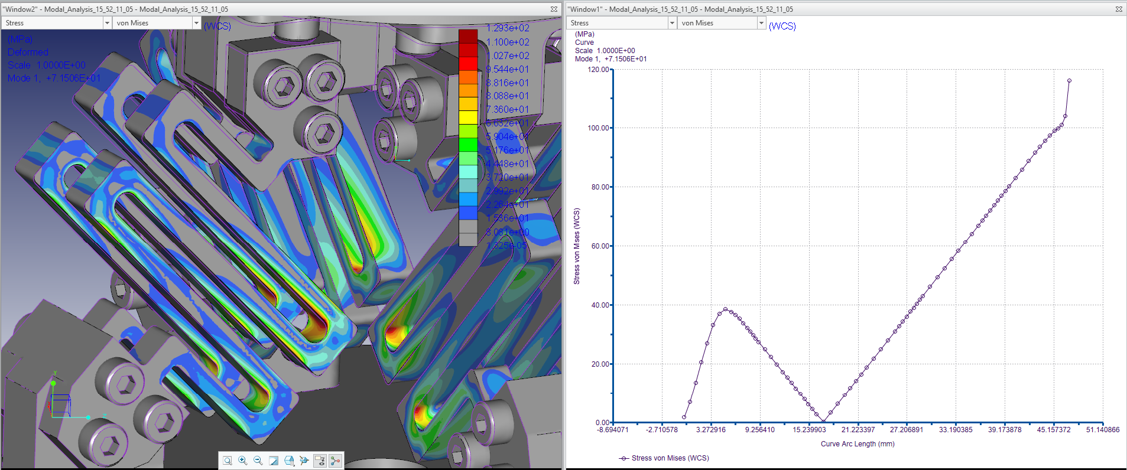

Slide 21
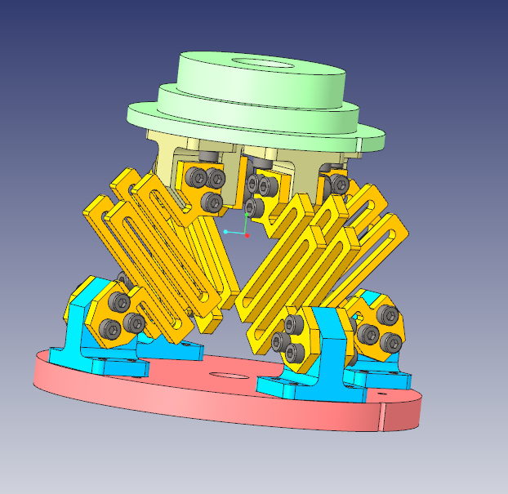
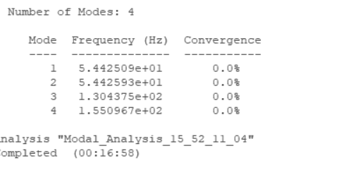
For 4 mm thick beam widths

Slide 22
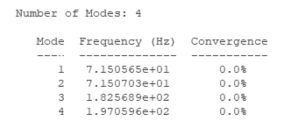
For 6 mm thick beam widths

Slide 23
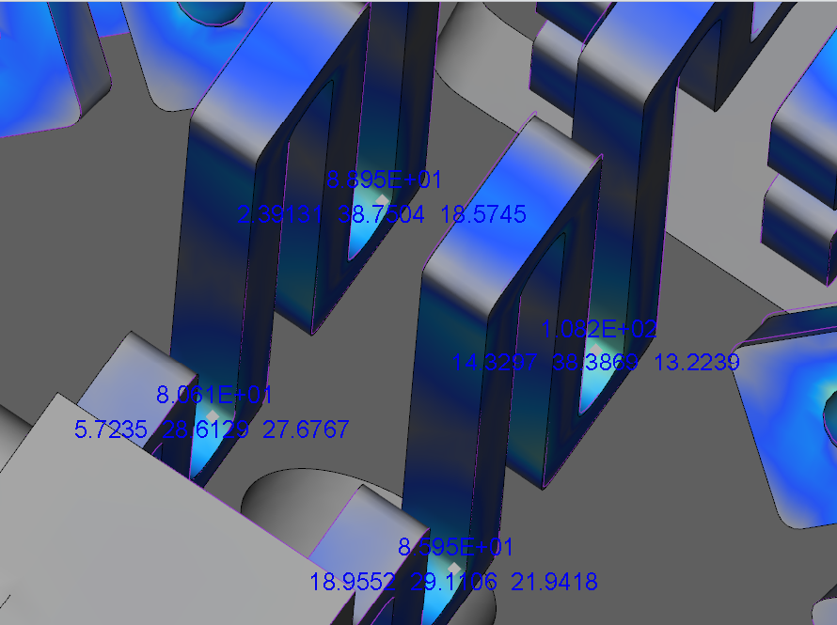
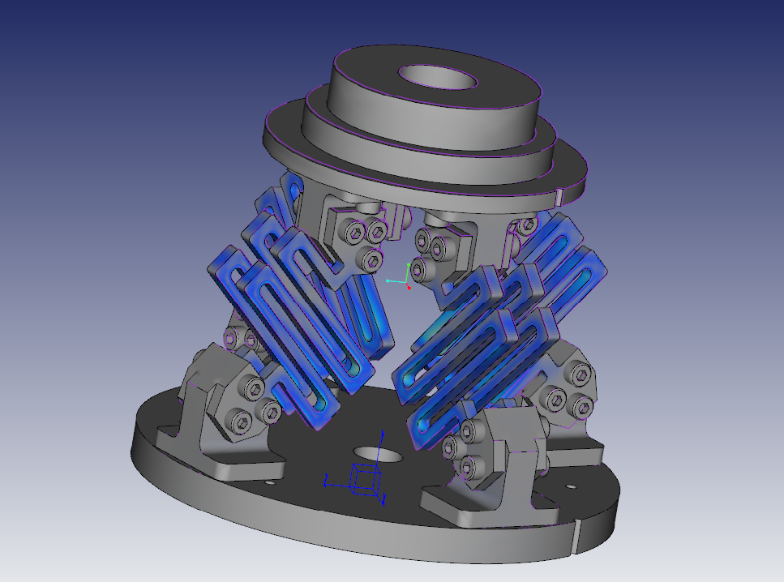

Slide 24
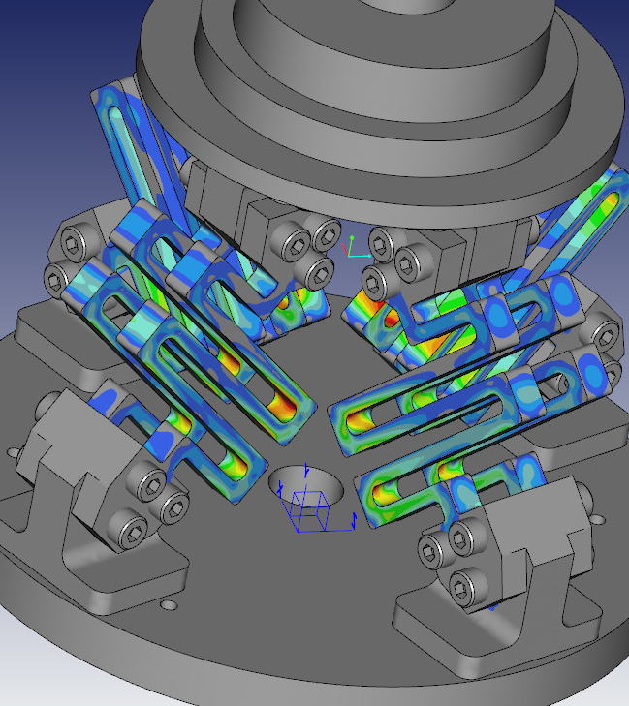
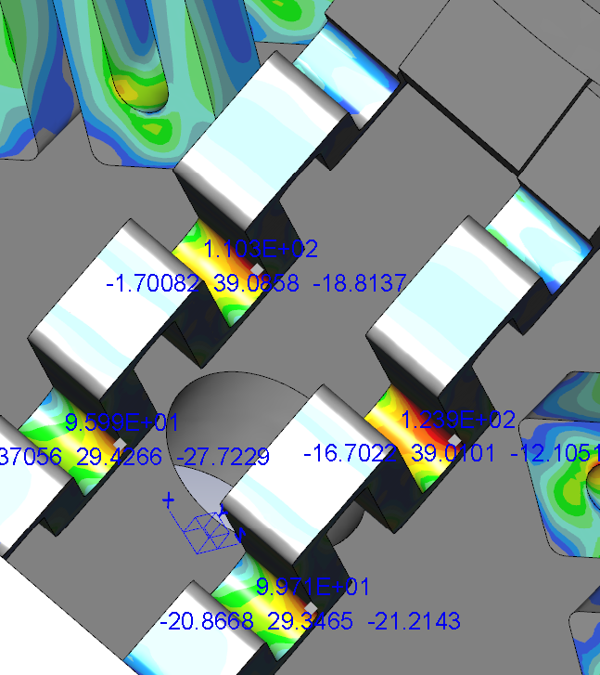

Slide 25
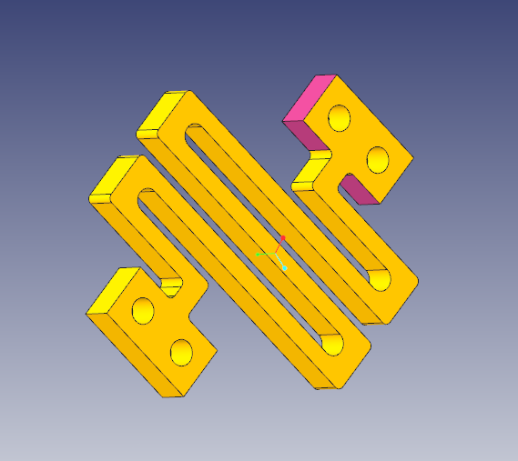
Top_ holes
Bottom_ holes

Slide 26
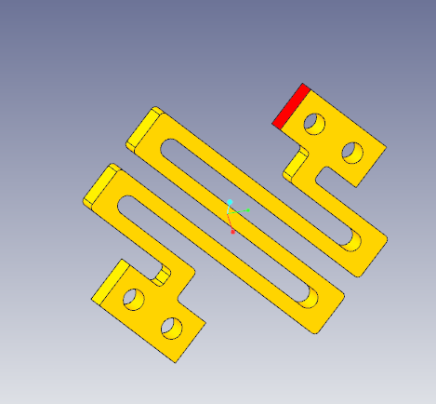
Top_ holes
Bottom_ holes

Slide 27
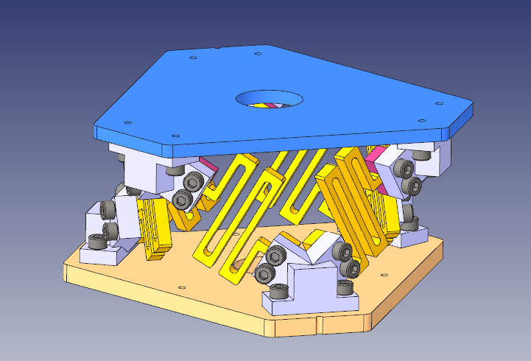

Slide 28
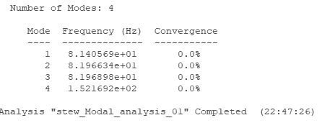
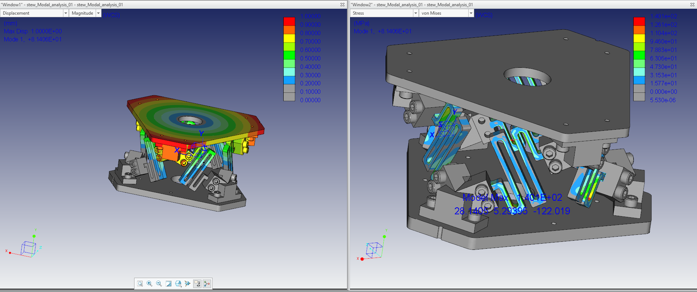

Slide 29
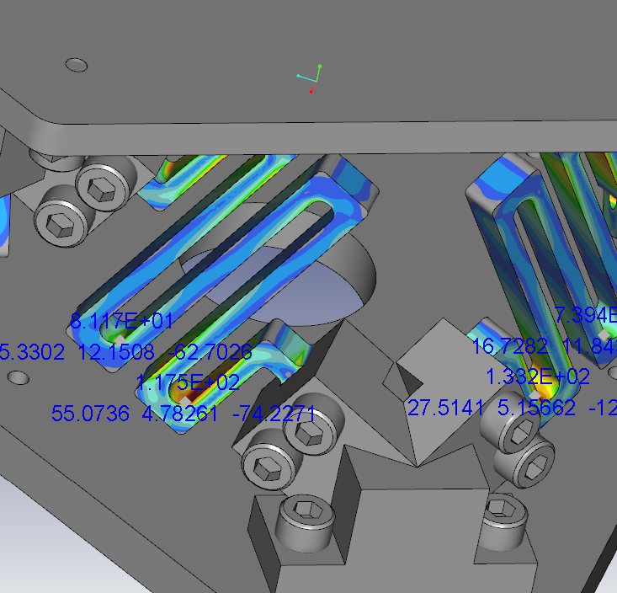
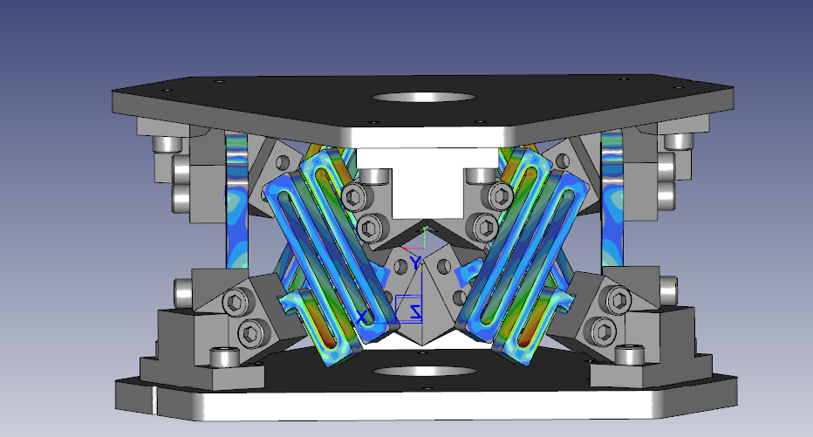

Slide 30
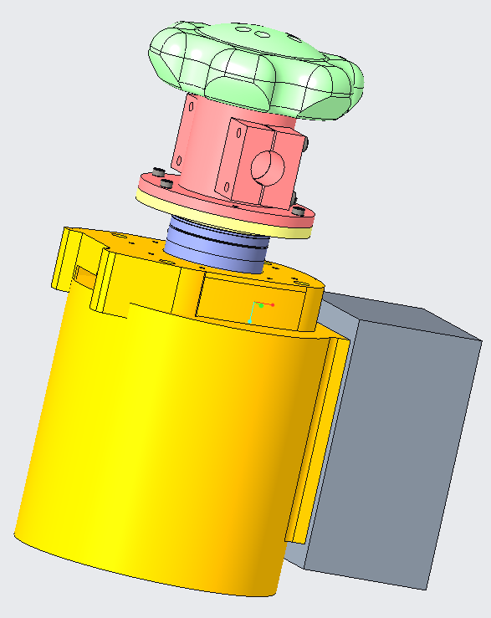

Slide 31
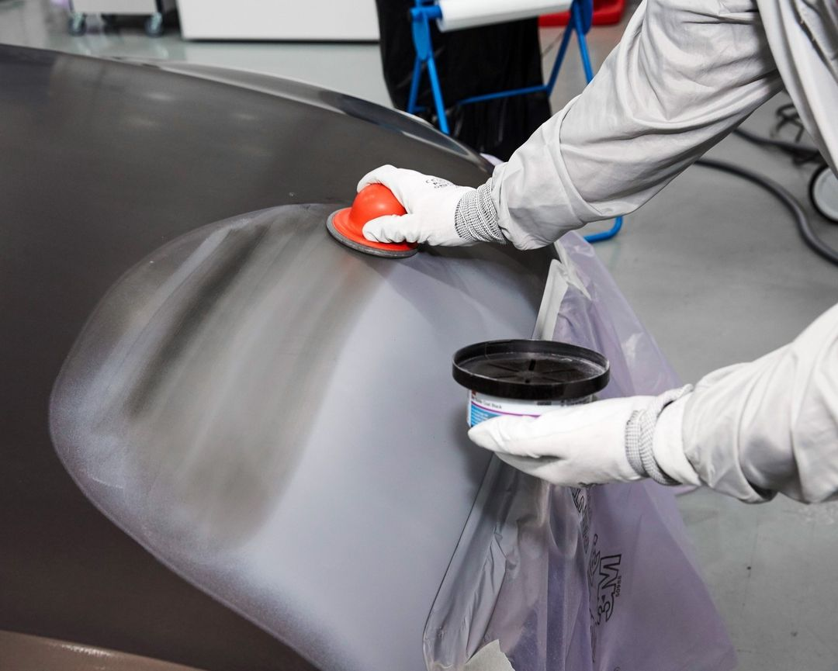
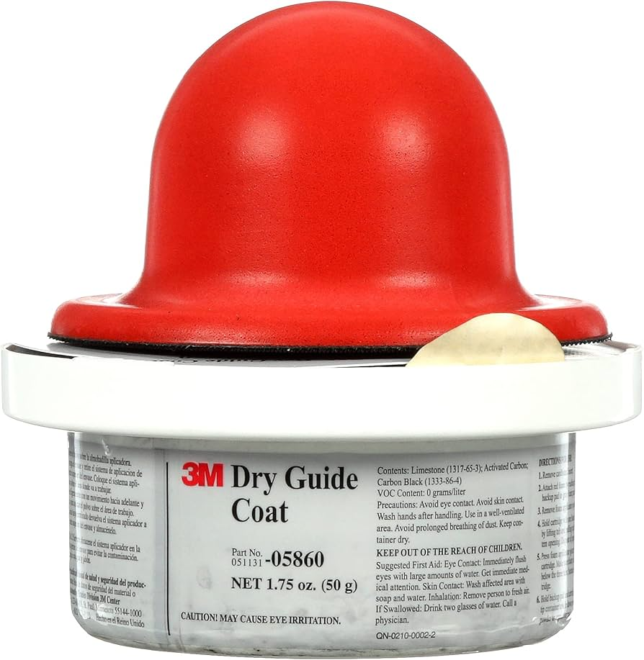

Slide 32
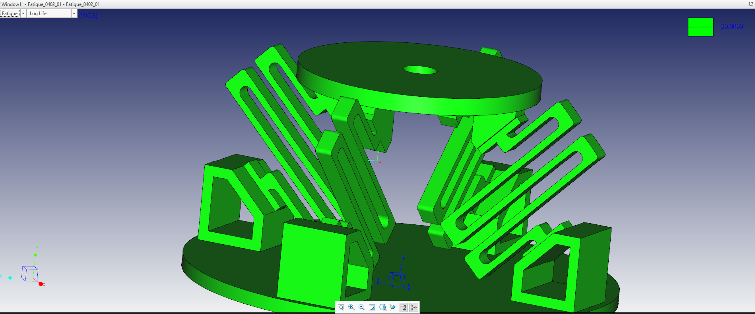

Slide 33
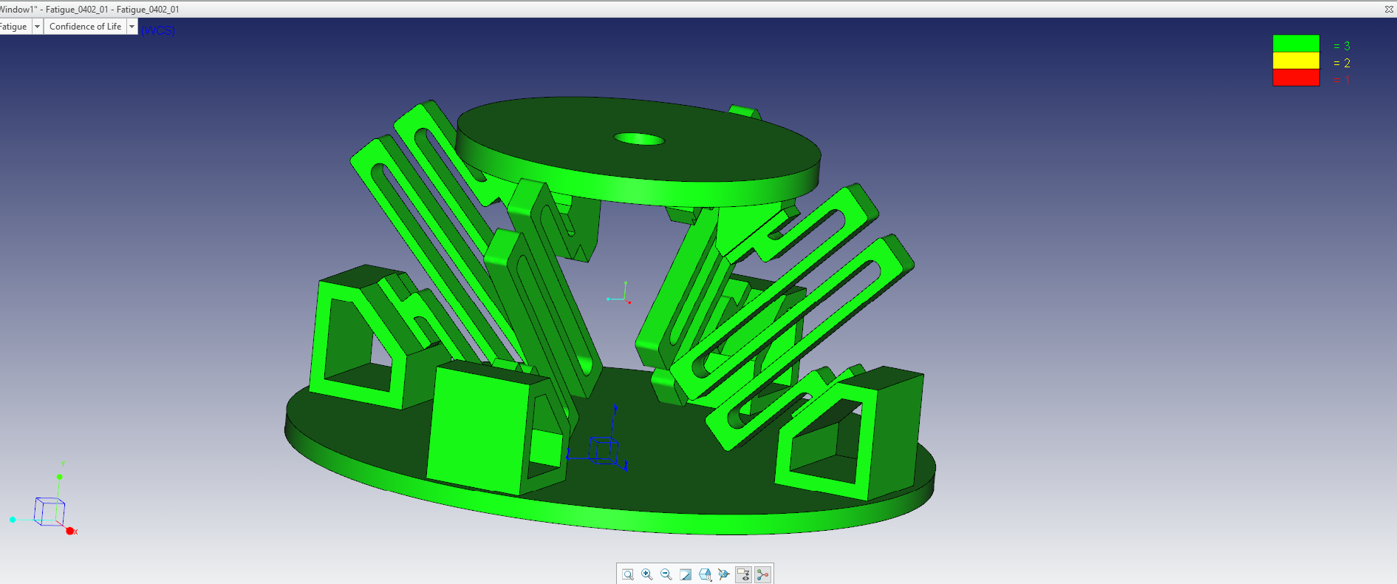

Slide 34
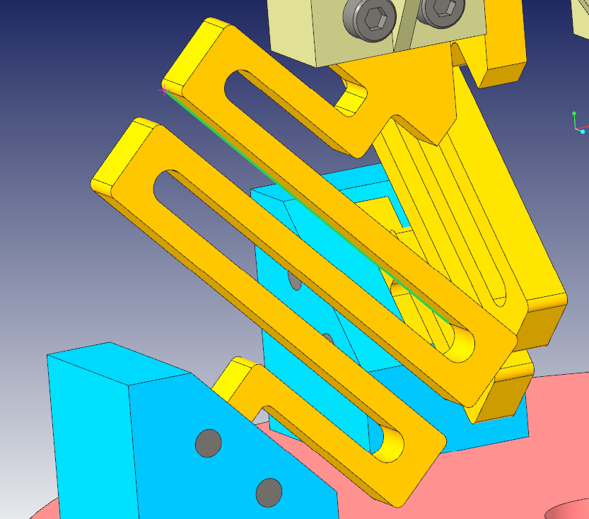

Slide 35
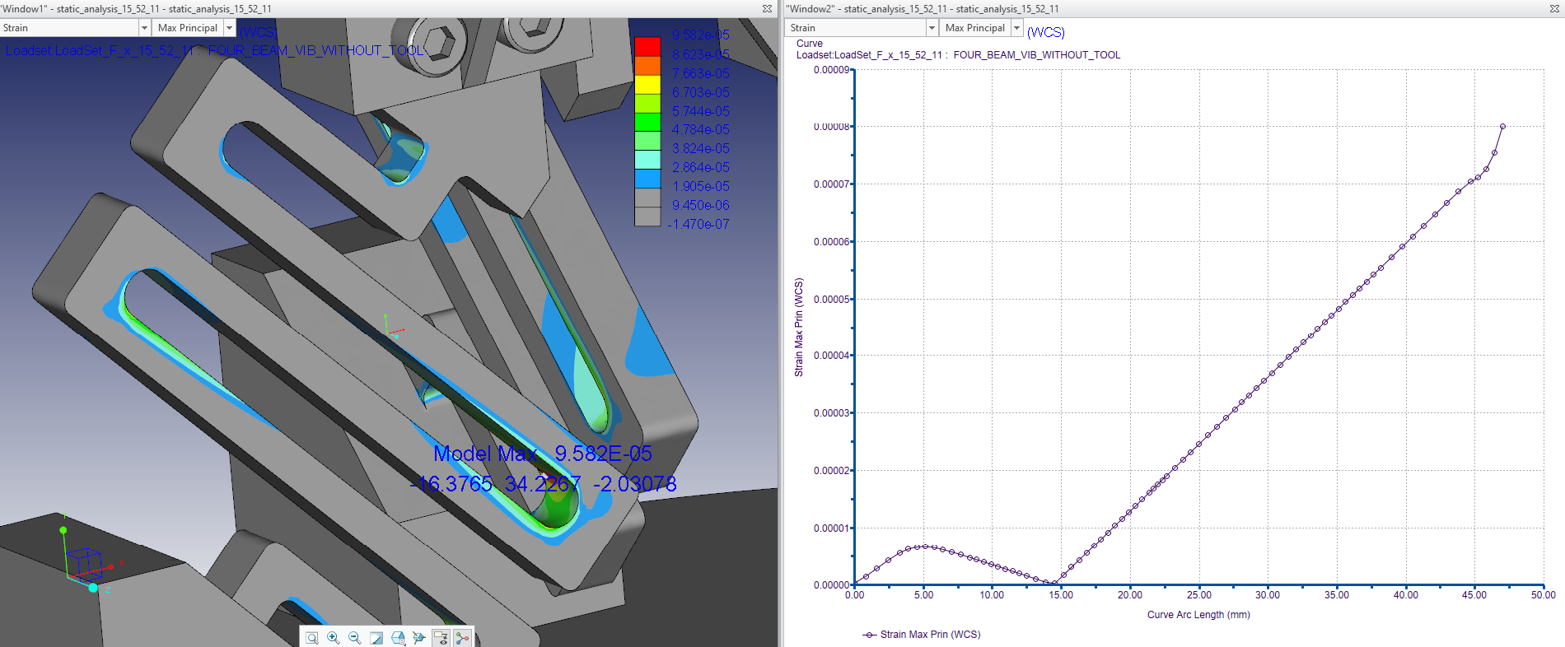

Slide 36


FOS = 4.056

Slide 37
Start
Design of CAD Model in Creo Parametric
Perform an modal analysis in Creo Simulate and obtain the initial Modal frequencies of the model
Then Run the Sensitivity Analysis to evaluate which design parameters influence the Model’s Modal frequency
Perform the Design Optimization Analysis in Creo Simulate
Select the parameters which are need to be optimized
Specify the design parameter range which is within the design limit also specify the design limits that needs to be satisfied
Specify the Optimization convergence and Maximum iterations.
If No
Run the Optimization Study with the optimize goal being set
does the result get converged?
If Yes
Display the Optimized design results
stop

